Slide 1
Help Wanted Online
A real-time measure of job postings
September 2025
Office of Research
Connecticut Department of Labor
Connecticut Department of Labor – Research Office
200 Folly Brook Blvd.
Wethersfield, CT 06109
Help Wanted Online

Slide 2
What is HWOL?
The Conference Board Help Wanted Online® Data Series (HWOL) measures the number of new, first-time Online job postings and jobs reposted from the previous month for over 50,000 Internet job boards, corporate boards and smaller job sites that serve niche markets and smaller geographic areas.
This workforce product was funded by a grant awarded by the U.S. Department of Labor's Employment and Training Administration. The product was created by the recipient and does not necessarily reflect the official position of the U.S. Department of Labor. The U.S. Department of Labor makes no guarantees, warranties, or assurances of any kind, express or implied, with respect to such information, including any information on linked sites and including, but not limited to, accuracy of the information or its completeness, timeliness, usefulness, adequacy, continued availability, or ownership. This product is copyrighted by the institution that created it. Internal use by an organization and/or personal use by an individual for non-commercial purposes is permissible. All other uses require the prior authorization of the copyright owner.
Connecticut Department of Labor – Research Office
200 Folly Brook Blvd.
Wethersfield, CT 06109
Help Wanted Online

Slide 3
Upcoming Release Dates
Monthly Report:
October 15th, 2025
Weekly New Ads Report:
Updated every Tuesday
Connecticut Department of Labor – Research Office
200 Folly Brook Blvd.
Wethersfield, CT 06109
Help Wanted Online

Slide 4
Statewide Weekly HWOL New Job Ads
Information on weekly new job ads by Employer, Industry, and Occupation can be found at:
https://www1.ctdol.state.ct.us/lmi/hwol.asp
This Information is updated every Tuesday.
Connecticut Department of Labor – Research Office
200 Folly Brook Blvd.
Wethersfield, CT 06109
Help Wanted Online

Slide 5
Statewide Monthly Highlights
- Total postings in Connecticut was 82,453 in August 2025, up from a July 2025 posting count of 86,307.
-Industry sectors with the most job postings were Health Care and Social Assistance (17,001 postings), Retail Trade (10,351 posting), Manufacturing (5,931 postings), and Professional, Scientific, & Technical Occupations
(5,263 postings).
-Occupations with the most postings were Registered Nurses (5,134 postings), Retail Salespersons (2,954 postings), Home Health and Personal Care Aides (2,714 postings), and Supervisors of Retail Sales Workers (1,627 postings).
Connecticut Department of Labor – Research Office
200 Folly Brook Blvd.
Wethersfield, CT 06109
Help Wanted Online

Slide 6
Top Skills in Connecticut Job Ads
Connecticut Department of Labor – Research Office
200 Folly Brook Blvd.
Wethersfield, CT 06109
Help Wanted Online

Slide 7
Top Qualifications in Connecticut Job Ads
Connecticut Department of Labor – Research Office
200 Folly Brook Blvd.
Wethersfield, CT 06109
Help Wanted Online

Slide 8
Connecticut Department of Labor – Research Office
200 Folly Brook Blvd.
Wethersfield, CT 06109
Help Wanted Online

Slide 9
Connecticut Department of Labor – Research Office
200 Folly Brook Blvd.
Wethersfield, CT 06109
Help Wanted Online

Slide 10
Connecticut Employers with the Most Job Ads
Connecticut Department of Labor – Research Office
200 Folly Brook Blvd.
Wethersfield, CT 06109
Help Wanted Online

Slide 11
Connecticut Occupations with the Most Job Ads
Connecticut Department of Labor – Research Office
200 Folly Brook Blvd.
Wethersfield, CT 06109
Help Wanted Online

Slide 12
Top Occupations in Industries With The Most Ads
Connecticut Department of Labor – Research Office
200 Folly Brook Blvd.
Wethersfield, CT 06109
Help Wanted Online

Slide 13
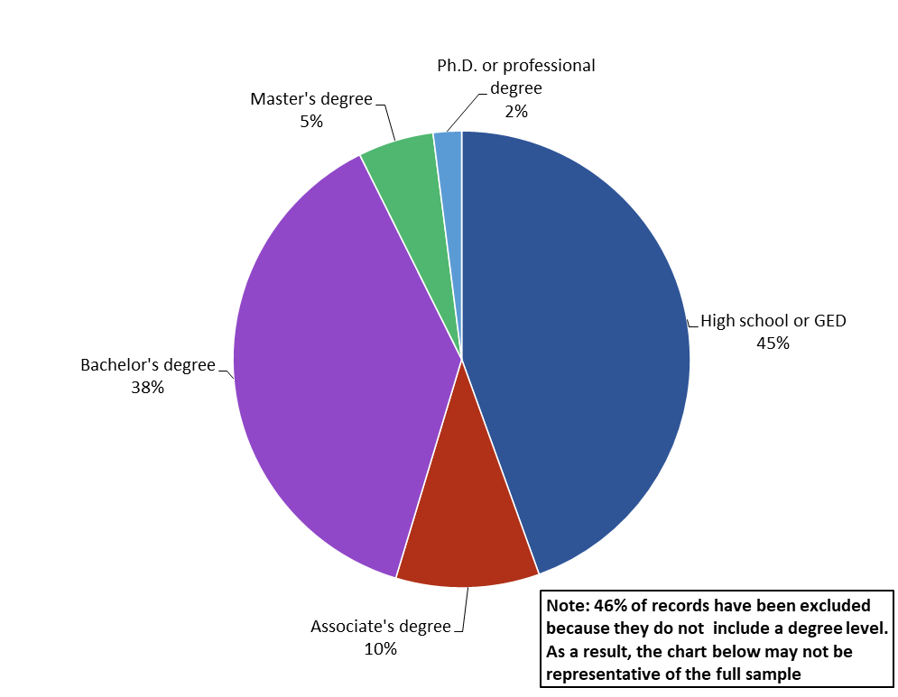
Connecticut Job Ads by Educational Requirements
Connecticut Department of Labor – Research Office
200 Folly Brook Blvd.
Wethersfield, CT 06109
Help Wanted Online

Slide 14
Workforce Area Data
Workforce Area Highlights
Job Ads by Industry
Job Ads by Location
Employers With The Most Job Ads
Occupations With The Most Job Ads
Connecticut Department of Labor – Research Office
200 Folly Brook Blvd.
Wethersfield, CT 06109
Help Wanted Online

Slide 15
Workforce Area Highlights
Connecticut Department of Labor – Research Office
200 Folly Brook Blvd.
Wethersfield, CT 06109
Help Wanted Online

Slide 16
Connecticut Department of Labor – Research Office
200 Folly Brook Blvd.
Wethersfield, CT 06109
Help Wanted Online

Slide 17
Eastern Workforce Job Ads by Location
Connecticut Department of Labor – Research Office
200 Folly Brook Blvd.
Wethersfield, CT 06109
Help Wanted Online

Slide 18
Eastern Workforce Employers
with the Most Job Ads
Connecticut Department of Labor – Research Office
200 Folly Brook Blvd.
Wethersfield, CT 06109
Help Wanted Online

Slide 19
Eastern WDA Occupations
with the Most Job Ads
Connecticut Department of Labor – Research Office
200 Folly Brook Blvd.
Wethersfield, CT 06109
Help Wanted Online

Slide 20
Connecticut Department of Labor – Research Office
200 Folly Brook Blvd.
Wethersfield, CT 06109
Help Wanted Online
20

Slide 21
North Central WDA Job Ads by Location
Connecticut Department of Labor – Research Office
200 Folly Brook Blvd.
Wethersfield, CT 06109
Help Wanted Online

Slide 22
North Central WDA Employers
with the Most Job Ads
Connecticut Department of Labor – Research Office
200 Folly Brook Blvd.
Wethersfield, CT 06109
Help Wanted Online

Slide 23
North Central WDA Occupations
with the Most Job Ads
Connecticut Department of Labor – Research Office
200 Folly Brook Blvd.
Wethersfield, CT 06109
Help Wanted Online

Slide 24
Connecticut Department of Labor – Research Office
200 Folly Brook Blvd.
Wethersfield, CT 06109
Help Wanted Online

Slide 25
Northwest WDA Job Ads by Location
Connecticut Department of Labor – Research Office
200 Folly Brook Blvd.
Wethersfield, CT 06109
Help Wanted Online

Slide 26
Northwest WDA Employers
with the Most Job Ads
Connecticut Department of Labor – Research Office
200 Folly Brook Blvd.
Wethersfield, CT 06109
Help Wanted Online

Slide 27
Northwest WDA Occupations
with the Most Job Ads
Connecticut Department of Labor – Research Office
200 Folly Brook Blvd.
Wethersfield, CT 06109
Help Wanted Online

Slide 28
Connecticut Department of Labor – Research Office
200 Folly Brook Blvd.
Wethersfield, CT 06109
Help Wanted Online

Slide 29
South Central WDA Job Ads by Location
Connecticut Department of Labor – Research Office
200 Folly Brook Blvd.
Wethersfield, CT 06109
Help Wanted Online

Slide 30
South Central WDA Employers
with the Most Job Ads
Connecticut Department of Labor – Research Office
200 Folly Brook Blvd.
Wethersfield, CT 06109
Help Wanted Online

Slide 31
South Central WDA Occupations
with the Most Job Ads
Connecticut Department of Labor – Research Office
200 Folly Brook Blvd.
Wethersfield, CT 06109
Help Wanted Online

Slide 32
Connecticut Department of Labor – Research Office
200 Folly Brook Blvd.
Wethersfield, CT 06109
Help Wanted Online

Slide 33
Southwest WDA Job Ads by Location
Connecticut Department of Labor – Research Office
200 Folly Brook Blvd.
Wethersfield, CT 06109
Help Wanted Online

Slide 34
Southwest WDA Employers
with the Most Job Ads
Connecticut Department of Labor – Research Office
200 Folly Brook Blvd.
Wethersfield, CT 06109
Help Wanted Online

Slide 35
Southwest WDA Occupations
with the Most Job Ads
Connecticut Department of Labor – Research Office
200 Folly Brook Blvd.
Wethersfield, CT 06109
Help Wanted Online

Slide 36
All advertisement data used in this publication is from the Conference Board’s Help Wanted Online data series.
For more information or data requests, contact Matthew Krzyzek in the Office of Research at the Department of Labor.
Matthew.Krzyzek@ct.gov
For more Connecticut Labor Market Information visit:
www.ctdol.state.ct.us/lmi
https://www.facebook.com/ctlmi
Twitter: @DOL_Research
Connecticut Department of Labor – Research Office
200 Folly Brook Blvd.
Wethersfield, CT 06109
Help Wanted Online

